Slide 1

NGOSA GATHAM
Master Cyber Security
Master Computer Science (India)
FILE CARVING AND DATA RECOVERY.

Slide 2

Computer data is information processed or stored by a computer.
This information may be in the form of text documents, images, audio clips, software programs, or other types of data.
Computer data may be processed by the computer's CPU and is stored in files and folders on the computer's hard disk

Slide 3

It is the process of salvaging data from damaged, failed, corrupted, or inaccessible secondary storage media when it cannot be accessed normally.
Recovery may be required due to physical damage to the storage device or logical damage to the file system

Slide 4
Data recovery means retrieving lost, deleted, unusable or inaccessible data that lost for various reasons.
Data recovery not only restores lost files but also recovers corrupted data.
There are software and hardware reasons that cause data loss, while we can recover data by software and hardware ways.

Slide 5

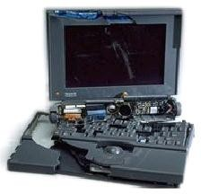
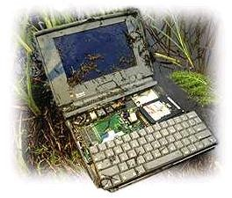
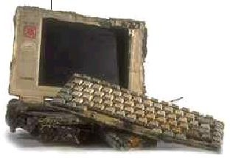
FIRE
Found after a fire destroyed a 100 year old home – All data Recovered
CRUSHED
A bus runs over a laptop –
All data recovered
SOAKED
PowerBook trapped underwater for two days – All data recovered

Slide 6

Average User:
  Recover important lost files
  Keep your private information private
Law enforcement:
  Locate illegal data
  Restore deleted/overwritten information.
  Prosecute criminals based on discovered data

Slide 7
Generally only restore data which was not yet overwritten.
Do not work on physically damaged drives
Examples of such recovery softwares are ’Recover my files’ , ’Ultimate recovery’ etc in windows platform and ’Ext3grep’, ’Recoverext3’ etc in Linux platform.
Prices range from Free – 1000

Slide 8

There are so many forms and phenomenon on data problem, we can divide the objects or scope of data recovery according to different symptoms

Slide 9

System problem

Slide 10
System problem
Can not enter the system or the system is abnormal or computer closes down.
Key file of system is lost or corrupted, there is some bad track on hard disk, the hard disk is damaged, MBR or DBR is lost, or the CMOS setting is incorrect and so on.

Slide 11
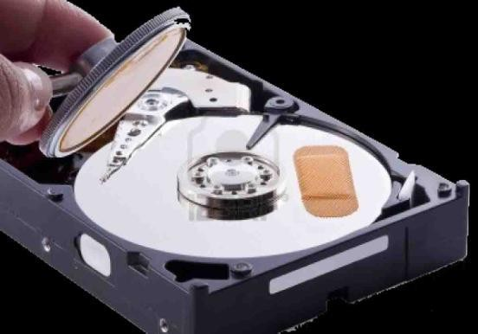
Logic and physical bad track.
Logic bad track is mainly caused by incorrect operation, and it can be restored by software.
While physical bad track is caused by physical damage, which is real damage, we can restore it by changing the partition or sector.

Slide 12
Partition problem
Partition cannot be identified and accessed
Partition is identified as unformatted
Partition recovery tools such as Partition Table Doctor can be used to recover data for these problems.

Slide 13

If files are lost because of deletion, format error, files restoring tools such as Data Recovery Wizard can be used to recover data.

Slide 14

Password loss
If files, system password, database or account is lost, some special decryption
tools that correspond to certain data form such as Word WinZip can be used.

Slide 15

Files repair
For some reasons, some files cannot be accessed or used, or the contents are full of
troubled characters, the contents are changed so as they can not be read.
In this condition, some special file restoring tools can be tried to restore the files.

Slide 16
Data recovery is a process of finding and recovering data, in which there may be some risk
It means maybe there will be some unexpected things going to happen. So we need to reduce the danger in data recovery to the lowest.

Slide 17
Backup all the data in your hard disk
Prevent the equipment from being damaged again
Don’t write anything to the device on which you want to recover data
Try to get detailed information on how the data lost and the losing process
Backup the data recovered in time.

Slide 18

Hidden files
Recycle bin
Unerase wizards
Assorted commercial programs
Ferrofluid
  Coat surface of disk
  Check with optical microscope
  Does not work for more recent hard drives

Slide 19
When data is written – the head sets the polarity of most,
but not all, of the magnetic domains
The actual effect of overwriting a bit is closer to obtaining a
0.95 when a zero is overwritten by a one, and a 1.05 when a one is overwritten with a one.
Normal equipment will read both these values as ones
However, using specialized equipment, it is possible to work out what
the previous “layers” contained
Steps include
  Reading the signal from the analog head electronic with a high-quality
digital oscilloscope
  Downloading the sampled waveform to a PC
  Analyzing it in software to recover the previously recorded signal.

Slide 20
Scanning Probe Microscopy (SPM)
  Uses a sharp magnetic tip attached to a flexible cantilever placed close to the surface to be analyzed, where it interacts with the stray field emanating from the sample to produce a topographic view of the surface
  Reasonably capable SPM can be built for about US$1400, using a PC as a controller
  Thousands in use today

Slide 21
Magnetic force microscopy (MFM)
  Recent technique for imaging magnetization patterns with high resolution and minimal sample preparation.
  Derived from scanning probe microscopy (SPM)
  Uses a sharp magnetic tip attached to a flexible cantilever placed close to the surface to be analyzed where it interacts with the stray magnetic field
  An image of the field at the surface is formed by moving the tip across the surface and measuring the force (or force gradient) as a function of position. The strength of the interaction is measured by monitoring the position of the cantilever using an optical interferometer.

Slide 22

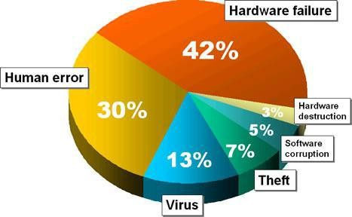
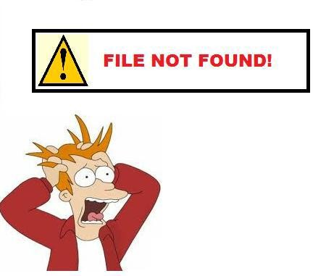

Slide 23
Software reason
Virus, format, mis-partition, misclone,mis-operation, network deletion, power-cut during operation all may be the software reasons.
The symptoms are usually mis-operation, read error, can not find or open file, report no artition, not formatted, password lost and troubled characters
We can use software tools to recover it.
So called soft recovery means data can be recovered by software

Slide 24
Hardware reason
Sometimes data loss is because of hardware, such as bad sector in hard disk, power cut, head damage, circuit panel problem, etc.
The speed of hardware become slow, cannot operate successfully; cannot read data, etc

Slide 25

Physical structure
HD consists of platter, control circuit board and interface parts.
A hard disk is a sealed unit containing a number of platters in a stack. Hard disks may be mounted in a horizontal or a vertical position.

Slide 26
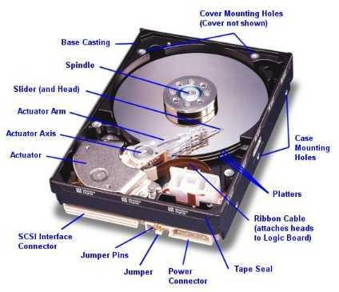
In this description, the hard drive is mounted horizontally.

Slide 27
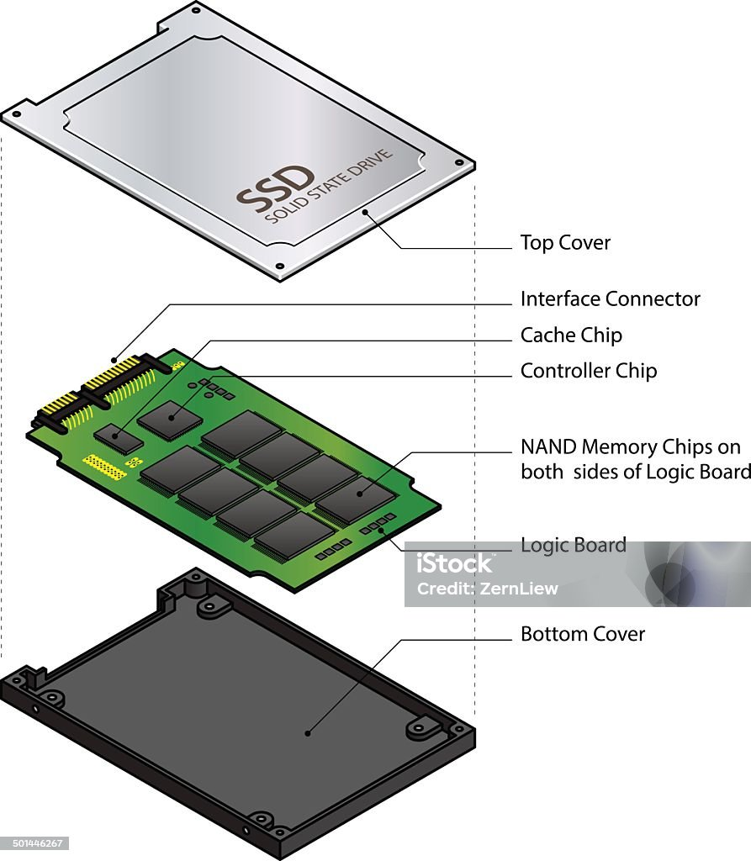

Slide 28

Primary formatting of hard disk
When hard disk is firstly made in the factory, it is usually “blank”.
Only after partitioning tracks and sectors, we can save data on hard disk

Slide 29
Data in hard disk divided into 5
MBR :master boot directory . The first physical sector. Bios or special firmware stored.
DBR : dos boot directory. First sector that is visited by os. store boot program and BPB (BIOS perimeter block).
FAT : it is a file system . Relatively uncomplicated.
DIR : means directory also called FDT. DIR is placed after FAT2
DATA :store the data

Slide 30

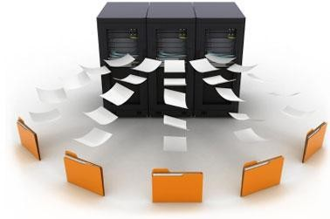

Slide 31
Root directory management in FAT32 partition
All files/folders in FAT32 have corresponding file entries record in FDT, each file entry records important information of the file/folder. The file system of operating system searches and localizes corresponding file/folder according to the file information in FDT of each partition.
Under FAT32,size of each FDT is 32 bytes.
FAT32 root directory management includes management of files with short and long filename, and management of directories under root directory..

Slide 32
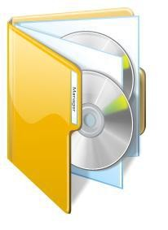
Management of sub-directory in FAT32
A parental directory may have many subdirectories, while a sub-directory has only one parental directory.
Under the sub-directory of root directory, we may create more inferior sub-directories, thus forming a directory tree.
For directories under root directory, its entrance still exists in root directory. .

Slide 33


When deleting a file, the system only makes a deletion mark on this file’s directory entry, marking clusters it covers in FAT as “empty”; clusters in DATA remains original file’s contents.
When writing in data again, the original file content might be covered by new information.

Slide 34


There is a Recycle Bin in Windows, The recycling bin is only some space on the hard disk
The Windows system automatically establishes a folder "RECYCLED" (under root directory of each disk partition) with hiding attribute to save temporarily deleted files.
Only when deleting or executing “Clear” command, these files then can be completely deleted (as to operating system).

Slide 35
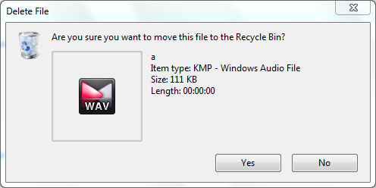
Fast deletion
Fast deletion of files is just to put them into Recycle Bin. In this situation, the data can be recovered.

Slide 36
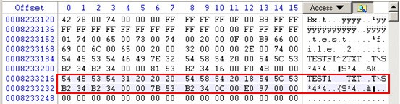
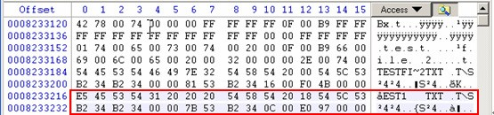
FDT before deleting “test1.txt”:
FDT after deletion:

Slide 37
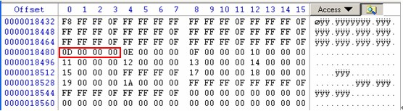
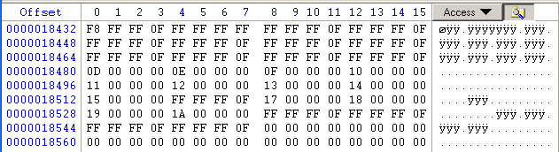
FAT before deletion
FAT after deletion

Slide 38
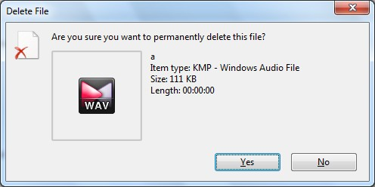
Complete deletion
how complete delete?

Slide 39
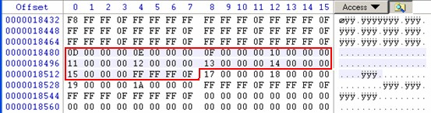
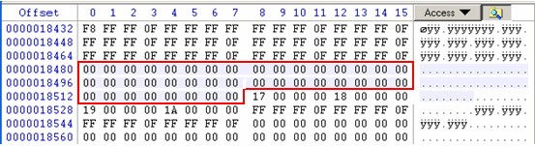
Complete deletion
FDT is the same as that of fast deletion. Before complete deletion, the content of FAT is:
After deletion

Slide 40


Operating system manages sub-directory in the same way as manages files. So, the deletion ways are same, too.
Fast deletion
Fast deletion of sub-directory is the same as that of files.
It just marked a deletion mark to the beginning byte in
FDT that describes subdirectory; all files under this sub-directory and records of its inferior sub-directory are not changed, that is, just to “remove” this subdirectory into recycling bin

Slide 41
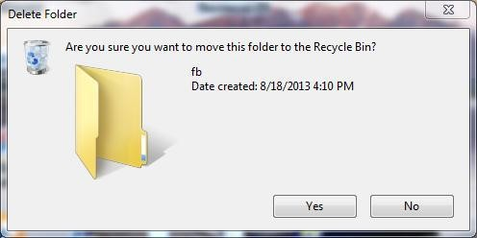
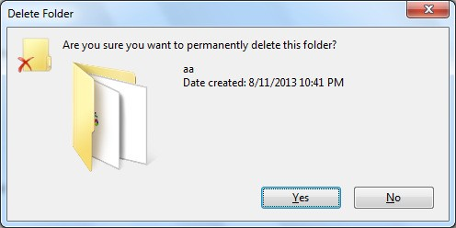
Complete deletion
Complete deletion is same as
that of in file..

Slide 42

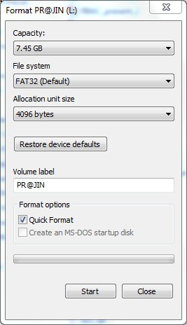
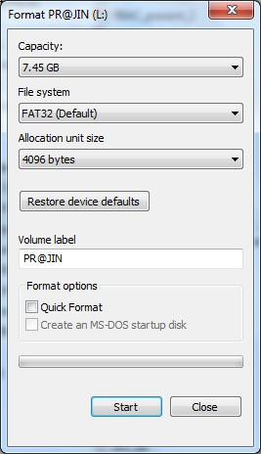
Complete high level format
Fast high level format

Slide 43

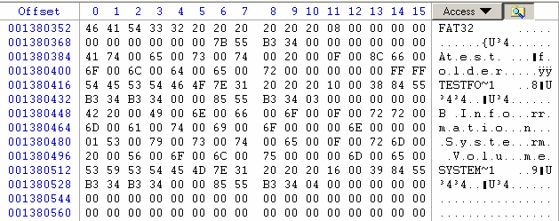
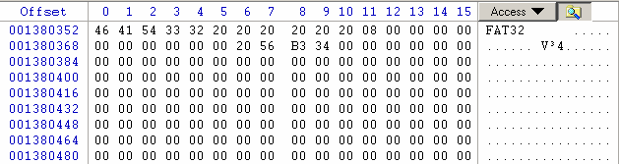
FDT before fast high level format:
FDT after fast high level format:

Slide 44

NTFS (New Technology File System) is a proprietary file system developed by Microsoft Corporation for its Windows NT line of operating systems
NTFS supersedes the FAT file system as the preferred file system for Microsoft Windows operating systems.
NTFS has several technical improvements over FAT and HPFS (High Performance File System), such as improved support for metadata, and the use of advanced data structures to improve performance, reliability and disk space utilization, plus additional extensions, such as security access control lists (ACL) and file system journaling.

Slide 45

FAT32
Maximum disk size: 2 terabytes
Maximum file size: 4 gigabytes
Maximum number of files on disk: 268,435,437
Maximum number of files in a single folder: 65,534
NTFS
Maximum disk size: 256 terabytes
Maximum file size: 256 terabytes
Maximum number of files on disk: 4,294,967,295
Maximum number of files in a single folder:
4,294,967,295

Slide 46


Never operate on partition (such as write and create file) where the data lost.
Please close any other application program when Data Recovery Wizard is running.
Make sure that there is no physical failure (such as physical bad track) on the disk you are operating. If there is any problem, please stop running Data Recovery Wizard, and send your disk to maintenance station.
Do not save the recovered files to the original partition. You need make sure that there is enough free space to save the recovered data; also you can save your files to removable devices or network devices.

Slide 47


Data recovery tools can be used to undo mistakes that you made that resulted in lost data.
Data consistency.
Digital forensics
To successfully use a data recovery tool you will need to determine the cause of your data loss.
A simple reboot cause the over writing of data
Data security.
Recovery may generate virus.

Slide 48
Bootable
Data recovery cannot always be done on a running system. As a result, a boot disk, Live CD, Live USB, or any other type of Live Distro containing a minimal operating system.
BackTrack:
Boot Repair Disk -
Hiren's BootCD:
SystemRescueCD:
Consistency checkers
CHKDSK:
Disk First Aid:
Disk Utility:

Slide 49
File recovery
CDRoller: Recovers data from optical discs.
Data LifeSaver (now "EASIS Data Recovery"): Data recovery for FAT and NTFS file systems.
Data Recovery Wizard: Microsoft Windows file recovery utility.
Drive Vaccine: Microsoft Windows Auto Restore of files on Reboot
FileSalvage: A Mac OS X recovery program.
IsoBuster: Recovers data from optical discs, USB sticks, Flash drives and Hard Drives.
Recuva: Microsoft Windows 2000 & later, FAT and NTFS.
TotalRecovery : Microsoft Windows. Bootable backup and recover system.
TuneUp Utilities: Microsoft Windows XP & later. A suite of utilities
that has a file recovery component.
Power Data Recovery: Data recovery software by MiniTool. 1GB free data recovery for personal use.

Slide 50
Forensics
EnCase: A suite of forensic tools developed by Guidance Software that is used for imaging and forensic analysis for UNIX, Linux, and Windows systems.
Foremost: An opensource CLI file recovery program, originally developed by the U.S. Air
Force Office of Special Investigations and NPS Center for Information Systems Security Studies and Research.
Forensic Toolkit: by AccessData, used by law enforcement.
Open Computer Forensics Architecture: An opensource program running on Linux.
The Coroner's Toolkit: A suite of utilities aimed at assisting in forensic analysis of a UNIX system after a break-in.
The Sleuth Kit: Also known as TSK, The Sleuth Kit is a suite of forensic analysis tools developed by Brian Carrier for UNIX, Linux and Windows systems. TSK includes the Autopsy forensic browser.

Slide 51
Companies, agencies, or individuals may want to ensure their data cannot be recovered.
Simple deletion is not good enough.
Faced with techniques such as MFM, truly deleting data from magnetic media is very difficult

Slide 52

Technique 2: Multiple Overwrites
Use an overwrite scheme
  Flip each magnetic domain on the disk back and forth as much as possible
  Overwrite in alternating patterns to expose it to an
oscillating magnetic field.
  Overwrite with “junk” data several times
Use the lowest frequency possible for overwrites
  Penetrates deeper into the recording medium

Slide 53
Peter Guttman’s overwrite scheme:
  Meant to defeat all possible recovery techniques (MFM, etc)
  Specifies 35 different overwrites
  Not all overwrites are needed if targeting specific recovery method (i.e. MFM)

Slide 54
Overwrite Data
Pass No.
Data Written
Encoding Scheme Targeted
1 - 4 | Random
5 | 01010101 01010101 01010101 0x55 | (1,7)RLL |  | MFM
6 | 10101010 10101010 10101010 0xAA | (1,7)RLL |  | MFM
7 | 10010010 01001001 00100100 0x92 0x49 0x24 |  | (2,7)RLL | MFM
8 | 01001001 00100100 10010010 0x49 0x24 0x92 |  | (2,7)RLL | MFM
9 | 00100100 10010010 01001001 0x24 0x92 0x49 |  | (2,7)RLL | MFM
10 | 00000000 00000000 00000000 0x00 | (1,7)RLL | (2,7)RLL
11 | 00010001 00010001 00010001 0x11 | (1,7)RLL
12 | 00100010 00100010 00100010 0x22 | (1,7)RLL
13 | 00110011 00110011 00110011 0x33 | (1,7)RLL | (2,7)RLL
14 | 01000100 01000100 01000100 0x44 | (1,7)RLL
15 | 01010101 01010101 01010101 0x55 | (1,7)RLL |  | MFM
16 | 01100110 01100110 01100110 0x66 | (1,7)RLL | (2,7)RLL
17 | 01110111 01110111 01110111 0x77 | (1,7)RLL
18 | 10001000 10001000 10001000 0x88 | (1,7)RLL
19 | 10011001 10011001 10011001 0x99 | (1,7)RLL | (2,7)RLL
20 | 10101010 10101010 10101010 0xAA | (1,7)RLL | MFM
21 | 10111011 10111011 10111011 0xBB | (1,7)RLL
22 | 11001100 11001100 11001100 0xCC | (1,7)RLL | (2,7)RLL
23 | 11011101 11011101 11011101 0xDD | (1,7)RLL
24 | 11101110 11101110 11101110 0xEE | (1,7)RLL
25 | 11111111 11111111 11111111 0xFF | (1,7)RLL | (2,7)RLL
26 | 10010010 01001001 00100100 0x92 0x49 0x24 |  | (2,7)RLL | MFM
27 | 01001001 00100100 10010010 0x49 0x24 0x92 |  | (2,7)RLL | MFM
28 | 00100100 10010010 01001001 0x24 0x92 0x49 |  | (2,7)RLL | MFM
29 | 01101101 10110110 11011011 0x6D 0xB6 0xDB |  | (2,7)RLL
30 | 10110110 11011011 01101101 0xB6 0xDB 0x6D |  | (2,7)RLL
31 | 11011011 01101101 10110110 0xDB 0x6D 0xB6 |  | (2,7)RLL
32-35 | Random

Slide 55
Extremely Extreme Physical Destruction
  Chainsaws
  Sledge hammers
  Drop in a volcano
  Place on apex of a nuclear warhead
  Multiple rounds from a high caliber firearm
Hard Drivers are tougher than you think

Slide 56

To reliably remove files?
Not Much - absolutely secure is very difficult given methods out today
Make it impractical or extremely expensive to recover

Slide 57

The data can be recovered only if the magnetic platter is not damaged
The recovery is highly complicated in case of some particular ultra hyper-tuned hard disk which has highly customized system area
The part replacement methods and the magnetic recovery are usually of high cost.
Both classes of recovery needs highly sophisticated laboratory setup.
Overwritten data

Slide 58

Improvements in algorithms that can predict the data in highly unrecoverable sectors and thus overcoming the failure to recover data due to ignorable bad sectors.
Improvement in strength of magnetic field that is used in magnetic force microscopy and signal tunnelling microscopy.
Improvement in algorithm that can extract data which is over written more number of times

Slide 59

The recovery data from the logically and/or physically damaged disk drives, and the recovery of overwritten data is now been done with a good amount of success.
The data recovery now have become a handy tool to the end-users as far as the logical damages are concerned, although the recovery of data from the physically damaged drives and over written data, which is done by the magnetic data recovery methods have still to reach at the end users, the data recovery industry has grown through heights of technology, that nowadays the situation is such that, data can be recovered from any physically damaged drive until it’s magnetic platters remain as such.

Slide 60
And in case of the magnetic recovery also the present state-of-the-art has contributed a lot to the data recover industry that the magnetic recovery had reported recover of data that had been over written upto 17 times.
Through part replacement the recovery of data from physically damaged drives has become easy.
With the use of magnetic force microscopy and Signal tunnelling microscopy the magnetic recovery of over written data also have become possible to great extend.

Slide 61

http://www.geocities.com/spezzin_grazer/ca p-4/cap4.htm
http://www.cs.auckland.ac.nz/~pgut001/pubs
/secure_del.html
http://sfgate.com
http://www.executivesoftware.com
http://www.softwareshelf.com
http://www.geek.com/news/
http://www.slashdot.com
http://www.compdisk.com

Slide 62


Slide 63


